Slide 1
Getting started with Embase – An introduction
XXXXX
Customer Consultant
XXXX@elsevier.com
August, 2017
Notes:
Embase supports many biomedical medical research area, such as evidence-based medicine, evidence based decision-making, drug safety monitoring, medical device safety and devices development.
Embase achieves it by delivering the trusted, structured biomedical information and precise retrieval tools.
Objectives:
Refresh basic knowledge about Embase
Learn how to do basic searches in Embase
For beginner users
Wish to gain Deep knowledge, refer you to previous webinar recordings for advanced searching skills, which can be found in support hub.

Slide 2
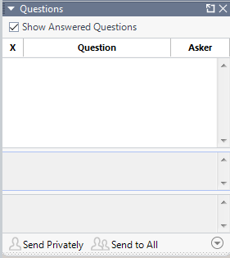
Agenda
Embase content and coverage
What is Emtree and how is Embase indexed?
How to search in Embase?
Demo
Q&A
Notes:
What will be covered:
content and coverage
Emtree. Here you will know how is Embase indexed
the basic searching techniques
Then go to Embase.com and demo searches and how to manage the searches
Time estimated: about 60 mins

Slide 3
Why do people use Embase?
Pharmacovigilance and drug safety
Clinical evaluation and device safety
Systematic review for evidence-based medicine
Notes:
Let’s start with a question in why - Why do people use Embase
Pharmaceutical companies primary use Embase to track and monitor the adverse events of drugs mentioned in the literature. This is required by the regulatory authorities such as FDA, EMA. Once the drug is on the market, manufactures are required to monitor and submit the drug safety report which includes information from literature.
Similarly for medical device. With recent release of New European Medical Devices Regulation and a revised Clinical Evaluation Regulation guidance, device companies are also required to submit the literature with relevant usable data to demonstrate the device safety. Literature also allows to gather the clinical information about the existing device, so device manufacture can demonstrate the benefit of a new device.
Field specialists, medical librarians and researchers use Embase to find the best evidence to support evidence-based medicine.

Slide 4

How Embase delivers value?
“When typing in keywords, Embase readily offers the best used terms. This is so very helpful. The layout of Embase is so well done.
“Efficient and useful tool for quick search through massive science data.
“Indexing is amazing!
“It's one of the most important databases for research in the medical field. When performing exhaustive searches in the medical field, the content of Embase has to be taken into account.
“More successful queries in this database than in Pubmed
“the ability to export the citation from the original list, as well as from most of the citations, has made the whole experience tremendously fruitful.
Notes:
People rely on Embase because:
it’s one of the most important database, when searching in the medical field, the content is needed
The deep Indexing let them find the relevant information
Search tools are useful to navigate in the sea of data
The possibility of save, export and manage the results improves the search experience.
And the user interface is friendly, and get more successful queries than other database
Embase delivers the value through Content, indexing, search tools and records management tools.

Slide 5
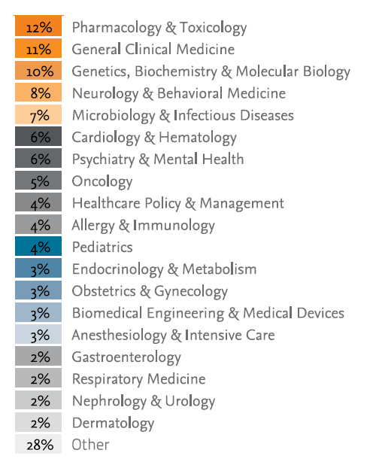
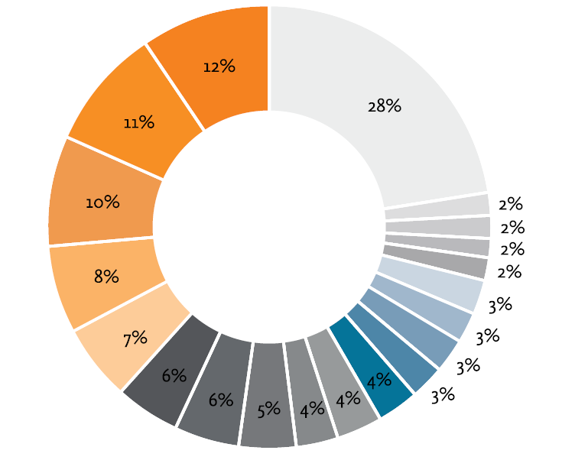
Embase focuses on biomedical literature in key areas for drug, disease and device research
Notes:
Content coverage:
Embase covers broad biomedical scope of literature, with a focus on pharmacology, toxicology, cardiology, oncology, and many pharmaceutical science and clinical research subjects.
Literature is dated back as early as 1947 until today.

Slide 6
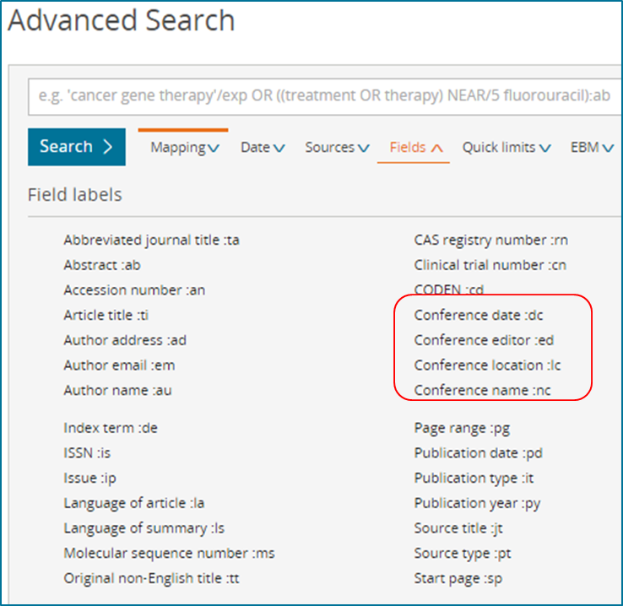
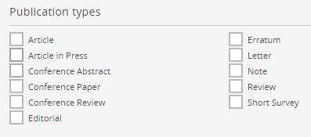
Unique coverage of conference abstracts
https://www.elsevier.com/solutions/embase-biomedical-research/embase-coverage-and-content
Notes:
In addition to the peer-reviewed journals, Embase covers
conference abstracts from 2009: this allows you access to the research before it’s published in a journal article. Conference abstracts can be search in various ways.
Article In Press: these articles have been accepted by the publisher for publication but have not yet been formally published. Currently Embase includes over 3000 journals as Article In Press.
The complete list of journal, article-in-press, and conferences can be found in the link below.
The journal and conference information are updated 2-3 times throughout the year.

Slide 7
Comprehensive content coverage
Embase
Almost 8,300 Journals, 33 Million Records!
2,900 journals not available on MEDLINE
MEDLINE
* Changed MEDLINE coverage since 2017 May due to Elsevier publisher embargo policy
** We are actively working to close the gap. Users can use this query to search the missing titles in MEDLINE
Notes:
Embase reaches over 33 million records (as of July 2017)
Among these records:
over 22 million can be found in MEDLINE
Over 10 million records are uniquely searchable in Embase
In May 2017, we announced the change of MEDLINE coverage in Embase. In terms of journal coverage, Embase covers 95% of MEDLINE content, with 275 titles in the gap.
Embase product team is actively working to close the gap.
Use the query provided to search these 275 titles particularly in MEDLINE

Slide 8
Comprehensive content coverage
Covered in Embase (≈ 8300 titles)
*
Indexed by Embase
by MEDLINE
*
Embase unique titles
≈ 3000
Embase/MEDLINE overlapping titles
= 3317
MEDLINE unique titles = 2037
* MEDLINE unique titles not covered in Embase (275 journal titles)
More content: MEDLINE In-Process and In-Press records and PubMed-not-MEDLINE records in Embase
Changed MEDLINE coverage since 2017 May due to Elsevier publisher embargo policy
As of July 2017
We are actively working to close the gap. Users can use this query to search the missing titles in MEDLINE
Notes:
This is another way to visualize the journals’ coverage
Embase has almost 8300 titles
Among the 8300 titles, about 6300 titles are indexed by Embase
There, about 3300 titles can be found in both Embase and MEDLINE. Embase indexes these records using its own taxonomy Emtree.
Then about 3000 titles are uniquely covered and indexed by Embase
Embase receives over 2000 titles’ records from MEDLINE. These records are indexed by MEDLINE. Embase map MEDLINE indexing to Emtree and include infomation in Embase.
There is a gap of 275 titles, since May not covered in Embase. this is showing in grey box. We are actively working to close the gap. We provide search query for these titles, so you can search them in MEDLINE
From January 2018, we will add MEDLINE In-Process and In-Press records and PubMed-not-MEDLINE records in Embase. As a user, you will be able to find MEDLINE content through Embase sooner than previously.

Slide 9

Worldwide coverage
Embase covers all the content contained in MEDLINE and unique coverage, including conference abstracts and European journals.
Source: Embase journal List May 2017
Notes:
Content coverage in the comparison to MEDLINE
Embase content extends to world wide coverage, including more European journals and Asian journals.

Slide 10
non-English content
Language | Embase (per year) | MEDLINE (per year) | Unique in Embase
English ** | 1,413,745 | 623,018 | 790,727
Chinese | 23,798 | 13,675 | 10,123
French | 12,094 | 6,170 | 5,924
Spanish | 12,333 | 4,273 | 8,060
Japanese | 6,703 | 5,010 | 1,693
Russian | 5,522 | 3,979 | 1,543
Portuguese | 2,718 | 1,493 | 1,225
Polish | 1,712 | 982 | 730
Turkish | 1,534 | 421 | 1,113
Korean | 364 | 146 | 360
[1] Search query: e.g [1-1-2016]/sd NOT [1-1-2017]/sd AND [dutch]/lim AND [embase]/lim NOT [medline]/lim
[2] Searched in Embase.com
Notes:
Non-English languages' records added in 2016
Embase has more unique content
For example,
the Chinese and French content are added in Embase is almost twice of that in MEDLINE;
Spanish language content was almost 3 times than that in MEDLINE.

Slide 11
More randomized controlled trials, especially non-English records
Language | Embase.com | MEDLINE (PubMed) | Embase Advantage | Percent
Chinese | 11042 | 7427 | 3615 | 49%
French | 3384 | 2876 | 508 | 18%
Spanish | 2876 | 2128 | 748 | 35%
Japanese | 2139 | 1237 | 902 | 73%
Russian | 2018 | 1923 | 95 | 5%
Portuguese | 1154 | 614 | 540 | 88%
Polish | 575 | 376 | 199 | 53%
Turkish | 944 | 109 | 835 | 766%
Korean | 193 | 83 | 110 | 133%
[1] Search query: e.g. 'randomized controlled trial'/NOT [31-5-2017]/sd AND [french]/lim
[2] Search query: e.g. ((("1000/1/1"[MeSH Date]:"20exp 17/5/31"[MeSH Date] AND medline[sb]) AND Randomized Controlled Trial[ptyp])) AND french[Language]
Notes:
non-English randomized control trials are important for systematic and drug safety monitoring.
Embase has more unique converge in various non-English languages.
[This concludes the part of content coverage in Embase.]

Slide 12
Indexing and Emtree

Slide 13
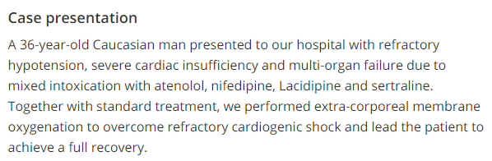

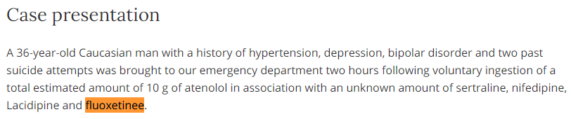
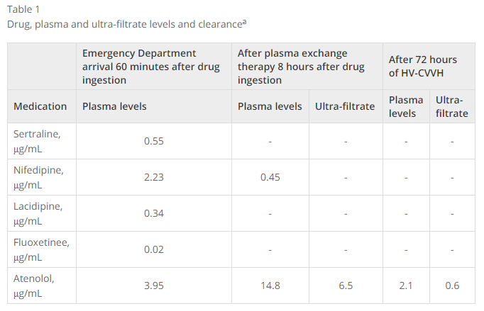
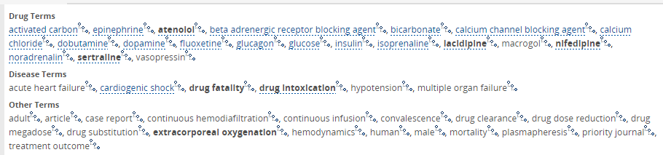
Importance of indexing
https://jmedicalcasereports.biomedcentral.com/articles/10.1186/1752-1947-5-231
Notes:
A case report of multi-drug intoxication
A patient presented in the hospital had 5 different medications, in combination of alcohol.
In abstract, only 4 drugs were highlighted.
However the full text article described the 5th drug co-used with other 4 drugs, which is fluoxetine.
Table 1 summaries the plasma level of fluoxetine upon Emergency Department (ED) arrival. If we only search title and abstract, you will definitely miss this particular drug information.
Because this article is a “PubMed – not – MEDLINE’ article. The drug information is not indexed in MEDLINE. You will not be able to retrieve this article by searching “fluoxetine’ in MEDLINE.
Differently, Embase indexes this drug term, and more

Slide 14
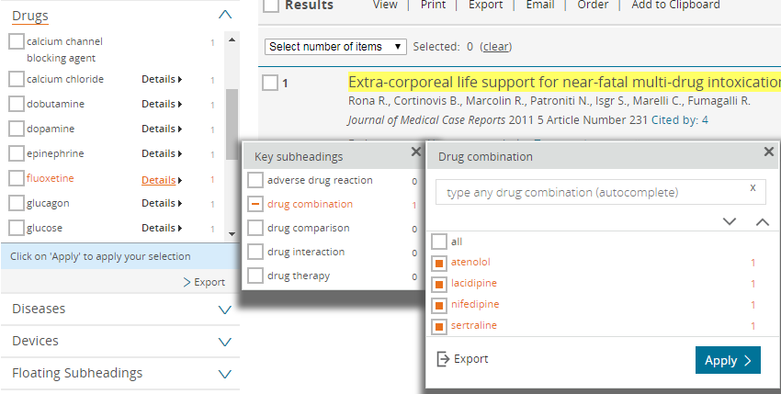
Importance of indexing
Notes:
fluoxetine and other drug combination information is indexed, too
The points:
Full text indexing, not only in title, abstract and citations
Manual indexing picks up the important information in the table, and assign the relationship
Information can be missed if only searching in one database

Slide 15

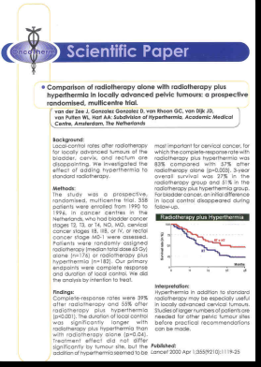
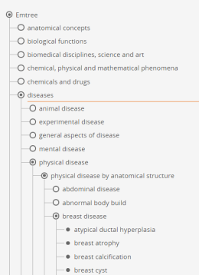
Indexing principles
Indexing for Embase is a manual process performed by trained indexers with a biomedical background, with the exception of articles designated for automatic indexing.
Indexers read and analyze the full text of articles in order to identify relevant concepts, and index them with the most specific Emtree terms.
Index terms are controlled by the Emtree thesaurus
resulting in consistent coverage of concepts that may be expressed in many different ways in the literature.
Notes:
Indexing principles
In Embase, Indexing is a manual process. Trained indexers with biomedical background
review literature in full text,
identify the concepts
add the specific terms to describe the concept.
These specific terms are controlled by the Emtree, and make sure the concepts are expressed consistently in many different ways in the literature.
As a result, you will be able to find the record, no matter how it is mentioned, and no matter where it is mentioned.
full-text and manual indexing is done for all the records, except the conference abstracts.
conference abstracts are indexed by machines.

Slide 16
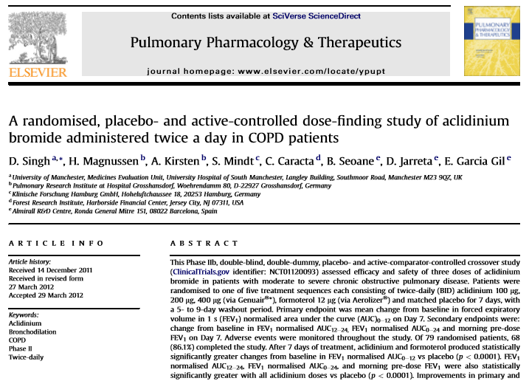
ScienceDirect.com
Notes:
<a randomised placebo- and active-controlled dose-finding study of aclidinium bromide administered twice a day in COPD patients.>
from science direct, published on Pulmonary Pharmacology and Therapeutics, in 2012.

Slide 17
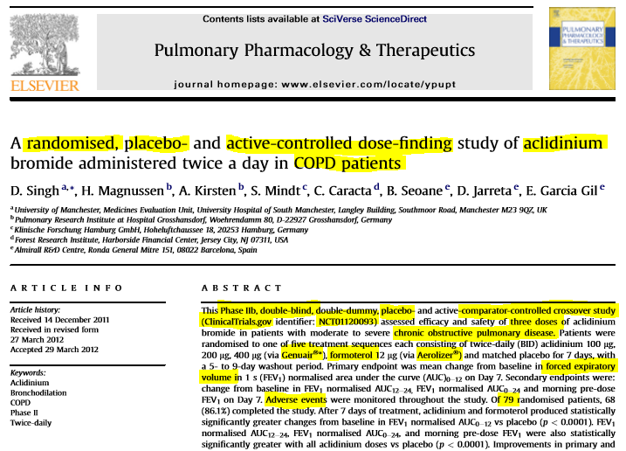
ScienceDirect.com
Notes:
First Indexer adds the terms to describe the subjects and information that will be interesting for the Embase users, such as drugs, devices, diseases. The highlights in titles and abstract are the terms that will be extracted by the indexer.

Slide 18
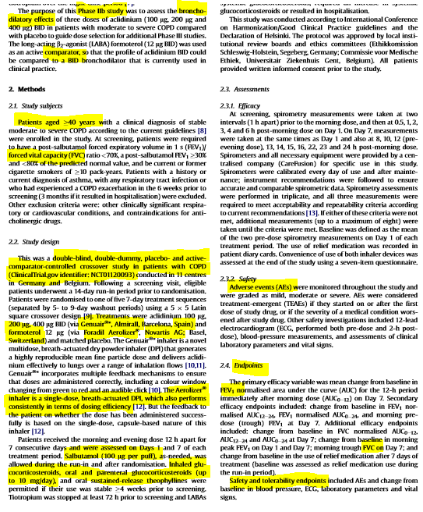
Embase indexing
The article full-text is read to extract significant concepts
Notes:
Indexers also read through the chapters in the full article, and pick up the information, concepts that were discussed about study design, patient group, dosage, adverse events etc.

Slide 19
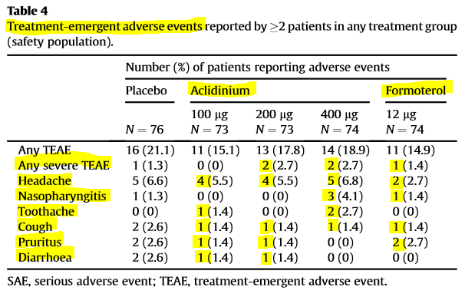
Embase indexing
The article full-text is read to extract significant concepts
Notes:
Importantly, information in the table are also picked by Indexer. In this example, you can see that adverse events listed in the table are also indexed.

Slide 20
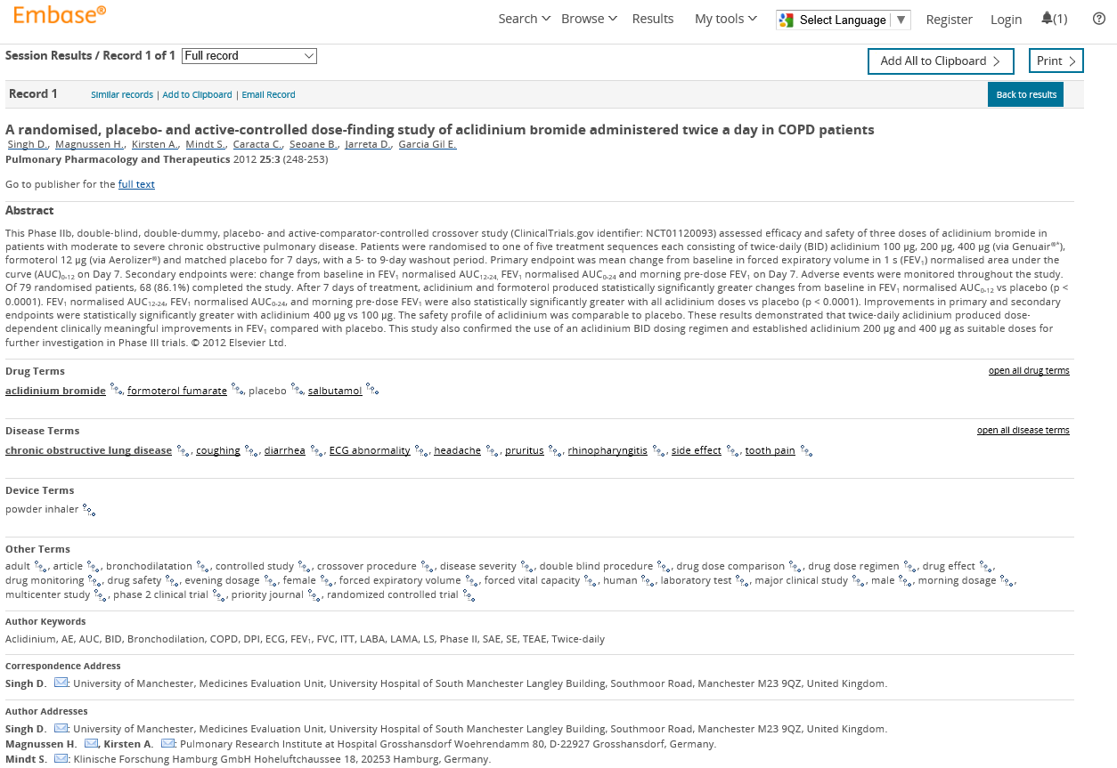
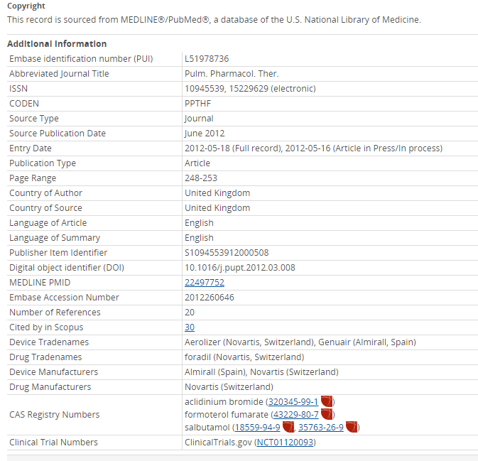
Notes:
All the information that has been picked up by the indexer will enter in Embase, as a record.
This screenshot shows you how a record looks like in Embase.com.
There is information about
title,
abstract,
also about drug terms, diseases, devices,
as well as author keywords etc.
(4) At the bottom of the record page, information, such as CAS number, clinical trial number are also included, and can be linked out to PubChem and ClinicTrial.gov.
To make sure the concepts that are expressed in many different literature are consistent, indexers should strictly follow the indexing guidelines and use Emtree, a controlled vocabulary for indexing.

Slide 21
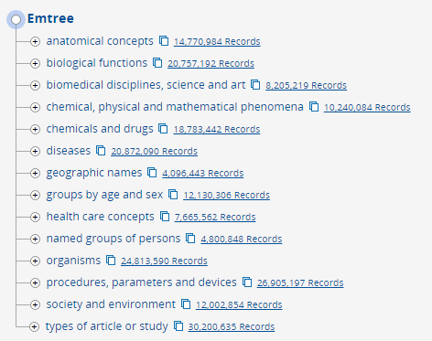
What is Emtree?
A controlled vocabulary for Biomedicine and related Life Sciences
What is facet?
The levels of a thesaurus subject hierarchy are called facets. Each facet represents a broad category of subjects.
Webinar Recording <systematic searching with Emtree> http://help.elsevier.com/app/answers/detail/a_id/18667/p/9754/
Notes:
So Emtree is Elsevier’s thesaurus for biomedicine and related life sciences.
Emtree is structured in 14 facets. Facet is also known as area, a classification or category of subjects.
The words or phrases that describe the same subject are grouped conceptually within one facet.
Emtree covers anatomical concepts, biological functions, organisms, drugs/chemicals, diseases, medical techniques and equipment, patient groups and so on.
Emtree has “+” icon, where you can click and expand top level and see more specific terms. The whole structure is unfolded like a tree.

Slide 22
Emtree Facts
75,000 preferred terms
320,000 synonyms
Drug Facet: 32,000 preferred terms and over 200,000 synonyms
Including all MeSH terms
Emtree update 3 times a year, including back-posting
https://www.elsevier.com/solutions/embase-biomedical-research/embase-coverage-and-content
Notes:
(1) (2) As of now, Emtree has over 75,000 preferred terms and more than 320,000 synonyms.
(3) Drug facet is the largest asset of Emtree, including over 32,000 preferred terms and more than 200,000 synonyms. Besides, Emtree has over 3,000 specific terms for general and medical devices (e.g. endoscopes, catheters, prostheses) as well as several thousand terms for related medical procedures, (e.g. endoscopy, catheterization
(4) Important for MEDLINE users, all the MeSH terms are included in Emtree, most are mapped in Emtree as synonyms. This means that users can simply use MeSH term to search in Embase.
(5) The latest drugs, diseases, organisms and procedures are indexed and added 3x per year (with back-posting of older records). This ensures the most recent substance, drug name are included timely.
More description about Emtree can be found in this webinar’s download links.

Slide 23
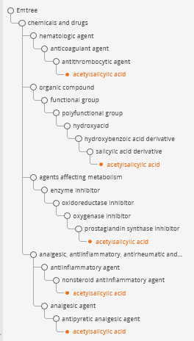
Explore Emtree
The hierarchy of terms defines the context
Drugs can be classified via different routes:
  Drug class:
    therapeutic use
    system affected
    mechanism of action
  Pharmacological activity
  Chemical structure
Notes:
In Emtree, we can explore to see the hierarchy and relationships between terms.
Drugs can be classified via different routes:
If searching by drug class, you find it through
therapeutic use
system affected
mechanism of action
You can also find the drug through Pharmacological activity and chemical structure

Slide 24
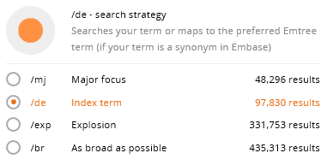
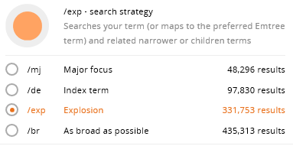
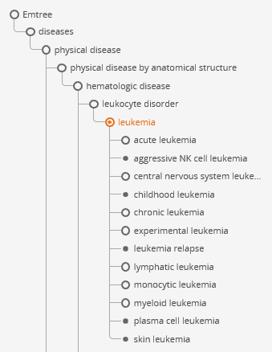
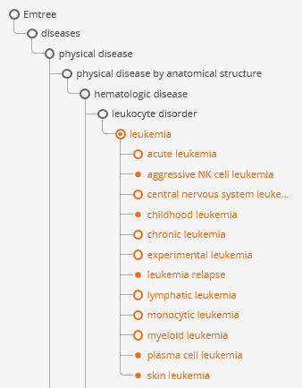
Make use of the Emtree structure: explosion searching
Notes:
Using Emtree to search in Embase, you will have many ways to control and balance comprehension and precision
/de: Searching index term or mapping to index terms retrieves precise articles that are indexed with this term
/exp: Using explosion search retrieves not only the preferred term, but also all the records indexed with narrower terms

Slide 25
Subheadings
Subheadings are Emtree terms that are also used as concept qualifiers for drugs, diseases and devices to refine their meaning, providing a very precise idea of what an article covers.
Side effect
Adverse drug reaction
Drug therapy
Drug therapy
Disease
Drug
Drug combination
Drug comparison
Device
Drug interaction
adverse device effect
Device comparison
Notes:
Drug, disease and device terms can be further qualified by searchable subheadings.
Subheading describe the precise meaning of drugs, diseases or devices in the article.
Drug combination gives the information about the drugs given in combination or concomitantly with other drugs.
Adverse drug reaction identifies a drug for which an undesired side effect is reported
Emtree has 82 subheadings, the most important are
Five key drug subheadings,
two device subheadings and
two disease subheadings.

Slide 26
Indexing: triple-linking
Triple-indexing is three level indexing of the full text of an article.
It consists of:
Term (drug or device or disease)
Key subheading (relationship)
Linked terms (e.g. stomatitis, hypertension, stroke, nausea, etc.)
Triple indexing has started in Q1 of 2007 for the drug triples (drug therapy from Q2 of 2009). Devices began in Q2 of 2014.
Everolimus
Adverse drug reaction
Stomatitis
Notes:
Subheadings provides idea of what topic is covered in the article.
From 2007, Embase starts adding another level of indexing, beyond the terms of drugs, device and disease, we now link an additional layer of information to the key subheading.
For instance, an article describes Stomatitis as the adverse event of drug Everolimus. This information is captured by indexers and can be explored in Embase using “triple Links”

Slide 27
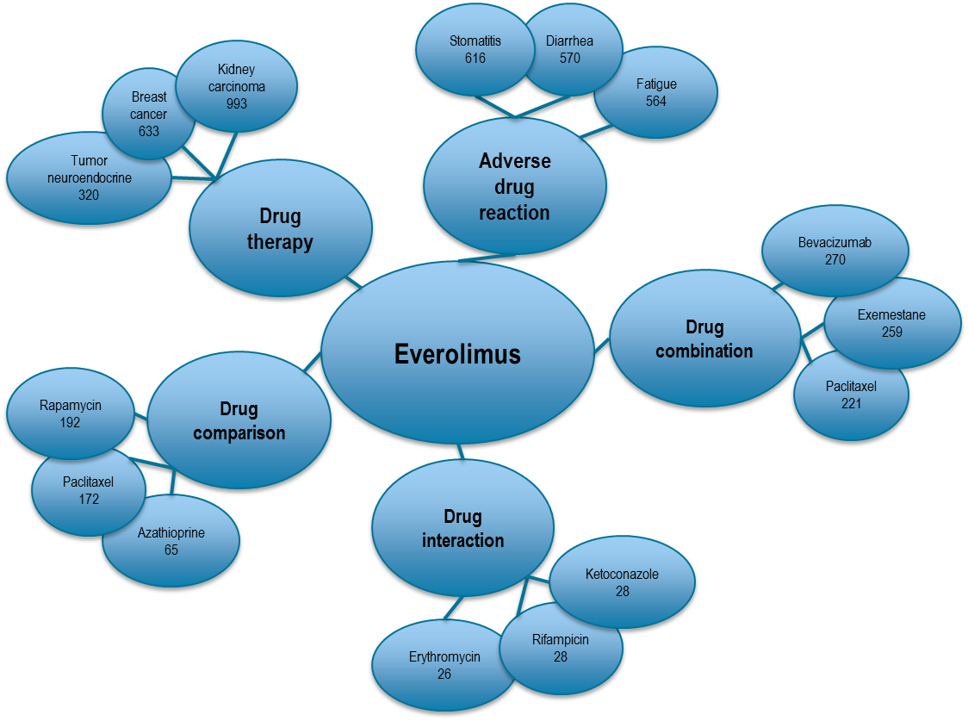
E.g. Triple indexing can be used to identify relationships of the drug Everolimus
Manually extracted semantic relationships
Triple linking and drug-repurposing
http://help.elsevier.com/app/answers/detail/a_id/11345/p/9754
http://help.elsevier.com/app/answers/detail/a_id/6082/p/9754
Notes:
With that, you can explore in Embase and answer some questions like
What are the common adverse drug reaction for Everolimus?
How is Everolimus compared with other drugs?
What diseases can be treated with Everolimus?
Advanced users: how to apply filters and find the triple-linking information

Slide 28
Tools in Embase.com
Notes:
With content and deep indexing, we will need a powerful search engine to facilitate the search and retrieve the precise information.

Slide 29
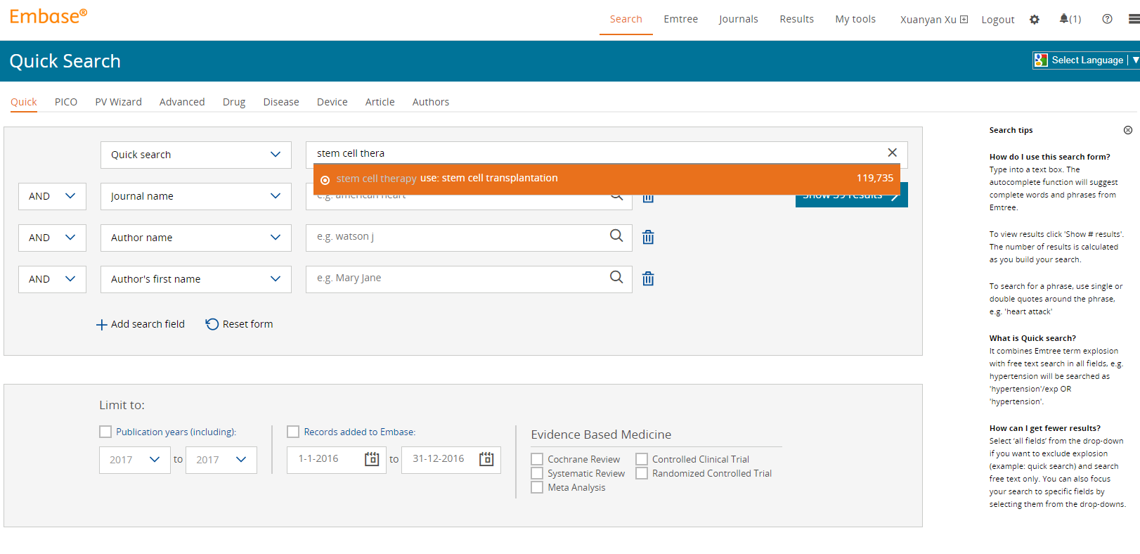
Search options
Browse options
Notes:
In Embase.com
By default: Quick search: Find the best terms of your search with autocomplete
PICO search
PV Wizard
Advance: more complex search, with more filters and limits options
Specific searches for drug, disease, device
Browse option:
Emtree: search terminology
Browse journals
Support hub and search tips

Slide 30
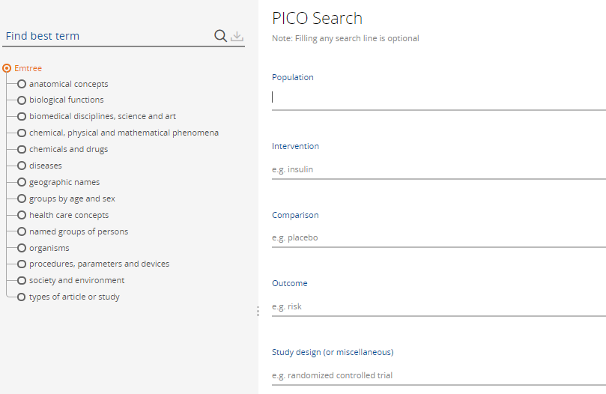
Using PICO search form for systematic searching
Notes:
PICO search form makes the systematic review searches easier and masters.
A clinical question can be sliced into 4 elements for population, intervention, comparison and outcome.
Each element will be automatically combined using the correct Boolean operators.
Users can also browse Emtree directly without going to the Emtree page, and they can see the Emtree hierarchy, read the information. Once Emtree term is added to the search query, all the synonyms of this term will be automatically listed and can be added in one click. This speeds up the process of building a comprehensive searches.

Slide 31
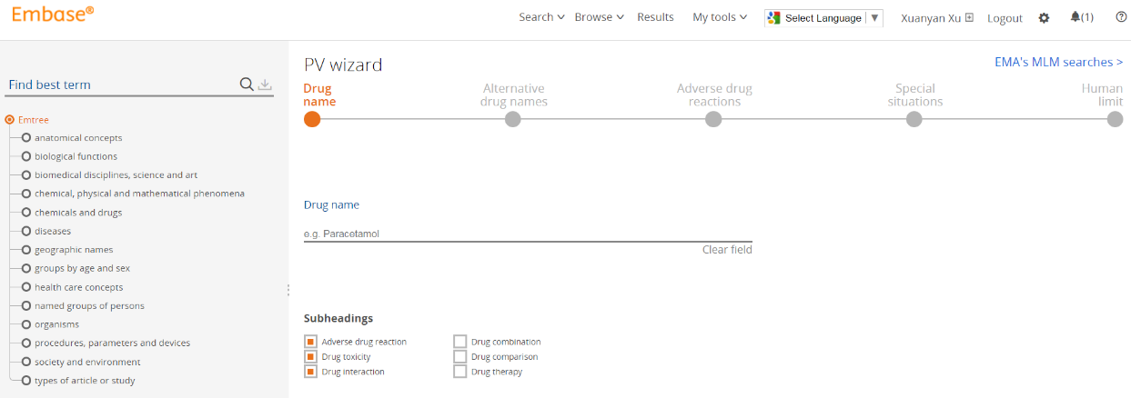
Using PV wizard search form
Emtree
MLM Query
Search Five elements
Edit Query
Pre-filled subheadings
Notes:
Leveraging the success with PICO search form, Embase released PV Wizard in May 2017. This query builder was co-developed with many industry experts.
This form includes:
Emtree and insertion of list of synonyms
pre-coded queries for adverse drug reaction, special condition and human limits are great asset for novice users
It shortens the query building process and ensures to include the adverse events as comprehensive as possible.
In addition to PV Wizard, we introduced EMA MLM search folder. This search folder consists 400 search queries that currently EMA uses to monitor 300 generic drugs and 100 herbals.

Slide 32
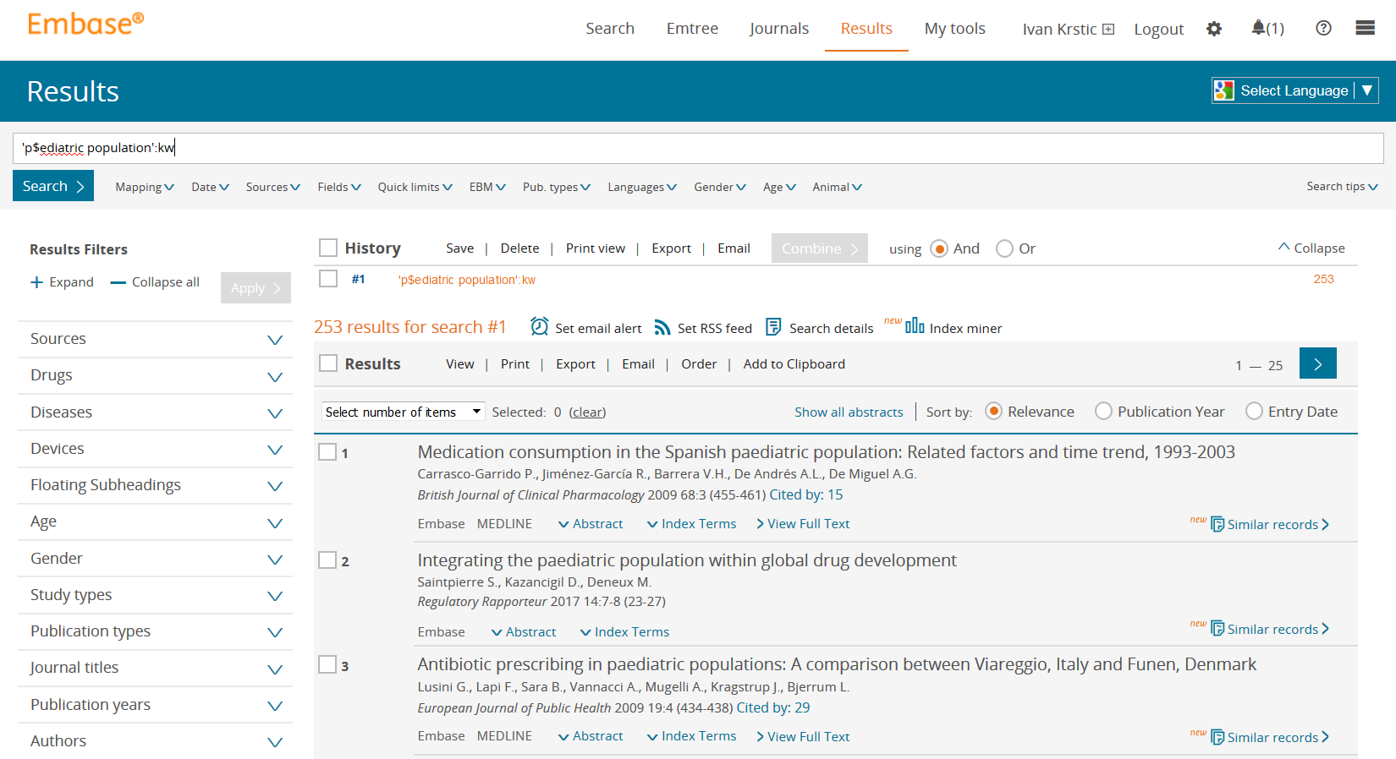
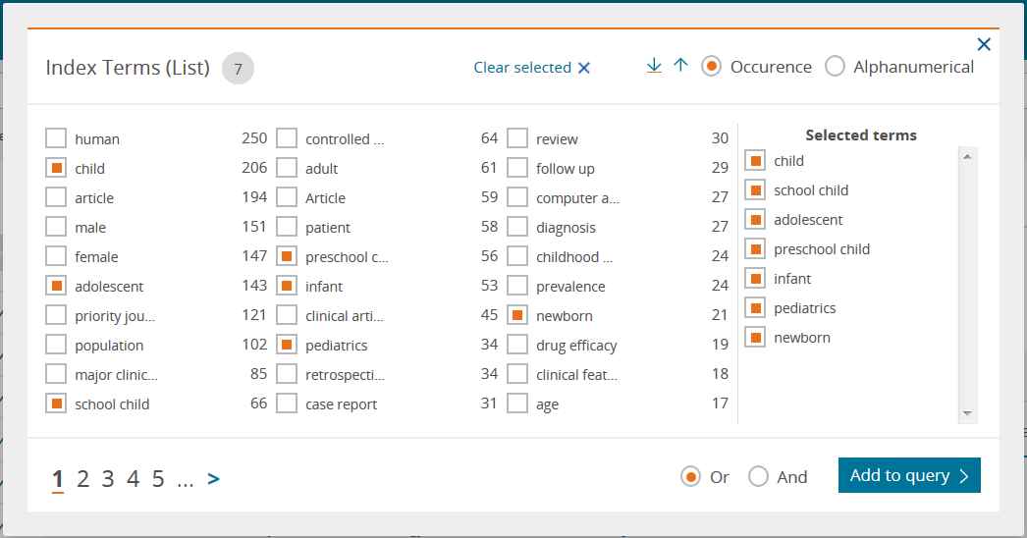
Index miner
This option will allow you to see the full list of indexed terms in the result set, and select the ones you want to include to expand the search.
Notes:
In July 2017, we released a new search function – index miner!
This option will allow you to see the full list of indexed terms in the result set. You can the review the list and select the relevant concepts to expand the search query. Boolean operators also allow you to limit your search to some particular concept of interest.

Slide 33
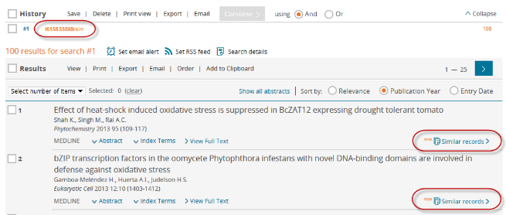
Find similar records
Embase will display 100 records similar to a record (e.g. L123456789)
Search syntax will be L123456789/sim
Search will be executed as a combination of major focus terms:
'term 1'/mj AND 'term 2'/mj OR ('term 1'/mj AND 'term 3'/mj) OR ('term 1'/mj AND 'term 4'/mj) OR ('term 2'/mj AND 'term 3'/mj) OR ('term 2'/mj AND 'term 4'/mj) … OR ('term n-1'/mj AND 'term n'/mj) NOT L123456789
Results will be sorted by relevance and limited to top 100
Notes:
Find similar records is another newly enhanced search function.
You can select one records. And what Embase does is to display the first 100 records similar to this specific record
This will also help you expand the search and find more relevant concepts.

Slide 34
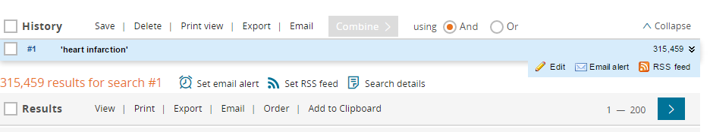
Managing results
Export, print or share results – choose from formats including RIS, text or CSV
Edit the search to apply additional limits
Set up e-mail alerts to automatically receive new search results (frequencies range from daily to yearly)
with Email alerts, exporting and advance searching
Notes:
Embase also includes a various tools for managing the searches and records.
(1) For individual search query
View Results
Edit
Copy to Advanced Search (or to whichever form you started your search)
Set email alert
Set RSS feed
(2) For search sessions
Save
Delete
Print view
Export
Email

Slide 35







How Embase delivers value?
...by including literature and information resources in a timely manner
Conference proceedings
Scientific
Journals
In Press (unpublished)
We make sure you don’t miss any
biomedical literature
...by reading full-text to identify drugs, diseases, adverse affects, clinical trials, drug trade names etc.
Deep indexing using own taxonomy (EMTREE)
The only close alternative is reading
all the articles
Very powerful
Search Environment
...by enabling advanced search filters and intuitive search tools to pinpoint relevant literature and manageable record set
Good precision and recall balance
...by allowing users to automate searching and result management
Automation and documentation
E-mail Alerting
API
Interoperability
Notes:
To re-cap what we have discussed, Embase delivers the value through content – indexing, search engine and records management tools.
Content Embase delivers is timely and international. We make sure you don’t miss any critical biomedical literature.
Deep indexing allows you to identify specific drug, disease and device concepts, and their relationship. This is the only close alternative instead of reading all articles.
Dedicated search tools balance precision and comprehension, allows you to pinpoint to the relevant and manageable set of records. The retrieved results can be managed in email alert, loaded to literature manage software.

Slide 36








Embase is recommended by the regulatory bodies and authorities for maintaining awareness of safety profiles
Committee for Medicinal Products for Veterinary Use (CVMP)
Notes:
Embase is recommended by the following regulatory bodies and authorities for maintaining awareness of safety profiles, and clinical and economic evidence:
European Medicines Agency (EMA) - Guideline on good pharmacovigilance practices (GVP) Module VI
European Commission - Guidance on the clinical evaluation of medical devices – MEDDEV 2.7.1 (rev. 4)
The National Institute for Health and Care Excellence (NICE) Guidelines
Cochrane Handbook for Systematic Reviews of Interventions Version 5.1.0
Recent acknowledgement by EMA Committee for Medicinal Products for Veterinary Use

Slide 37
Basic searching

Slide 38
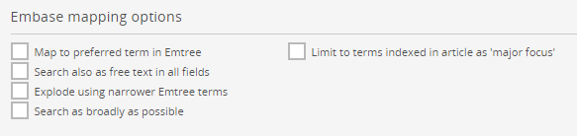
Mapping: Level of comprehensiveness
/de: search the preferred term
Stem Cell Therapy is a synonym of Stem Cell Transplantation
Searching ‘stem cell therapy’ will be mapped to searching the preferred term ‘stem cell transplantation’
‘stem cell therapy’/de 36,166
‘stem cell transplantation’/de 36,166
Notes:
In Embase, you will find different mapping options
Done by /de or check the box in the filter
E.G.
Stem Cell Therapy is not a preferred term, it is a synonym of Stem Cell Transplantation
Using /de to search ‘stem cell therapy’, it will be mapped to searching the preferred term ‘stem cell transplantation’
Results are the same

Slide 39
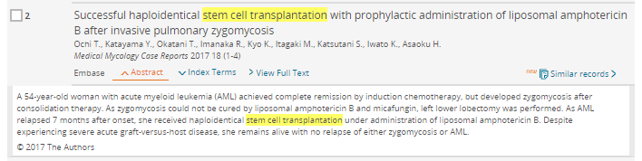
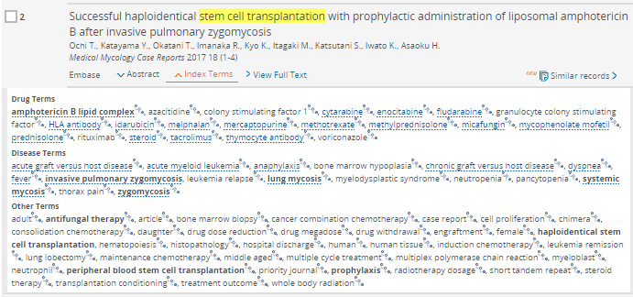
Mapping: Level of comprehensiveness
search in all fields of a record
including title, abstract, author keyword, institute name, all fields
Notes:
This option runs a text search across the all the fields of a record, including title, abstract, keywords, author keywords, author address

Slide 40
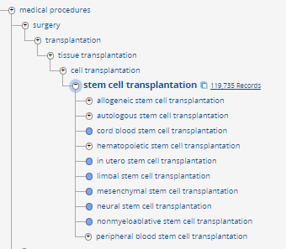
Mapping: Level of comprehensiveness
/exp: explode using narrower Emtree terms
Preferred term (/de)
Narrower terms – included in an /exp search
Notes:
Done by using /exp, or check the box
Search term will be mapped to preferred term
All the specific terms under the preferred term will be all searched
Stem cell transplantation has more specific categories in the list, such as allogeneic stem cell transplantation, autologous stem cell transplantation etc. Embase indexers should always use the most specific term available to describe the content of an article.
Using explosion search saves you time to search individual sub-categories separately. This search type will increase your search results dramatically.

Slide 41
Mapping: Level of comprehensiveness
/br Search as broad as possible. It combines:
  Map to preferred term in Emtree
  Search also as free text in all fields
  Explode using narrower Emtree terms
‘stem cell transplantation’/exp 119,735
‘stem cell transplantation’/br 130,135
'stem cell transplantation'/exp OR 'stem cell transplantation‘ 130,135
Notes:
You can also Search as broadly as possible
Done by using /br or check in the box
What Embase does is to combine the results of the following 3 searches:
It Maps to preferred term in Emtree
It Searches free text in all fields
It Explodes using narrower Emtree terms
Broad search increases search results.

Slide 42
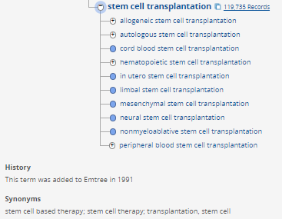
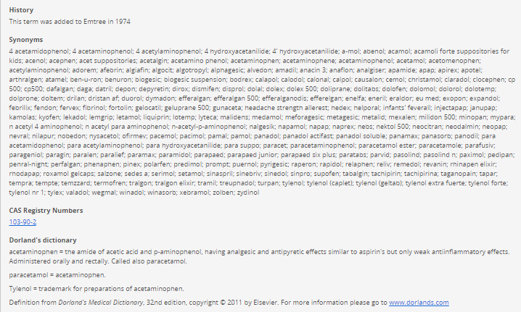
Synonyms
Notes:
Synonyms are the equivalent to an Emtree term.
Emtree allows to browse synonyms of the term. In addition to explosion search and preferred term search, searching synonyms in all fields of a records help to retrieve more information.
Some terms have a long list of synonyms.

Slide 43
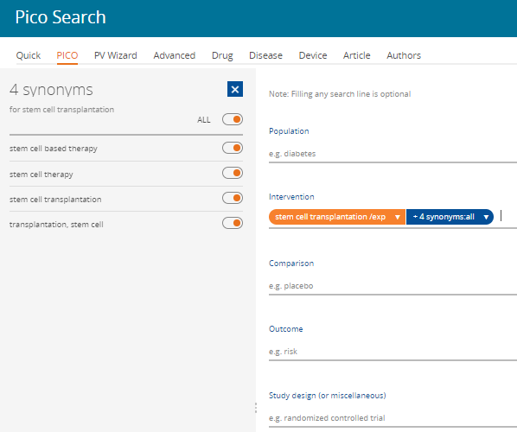
Using PICO to include synonyms
Notes:
Using PICO or PV Wizard to directly inject the list of synonyms to the search query. It will save you the time to search individual synonym and add it separately

Slide 44
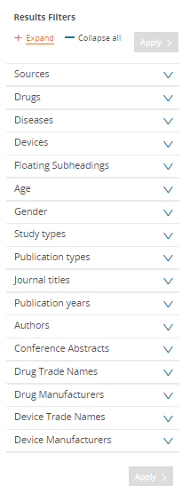
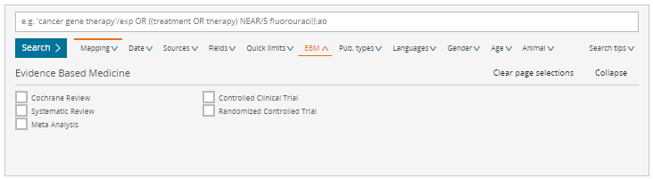
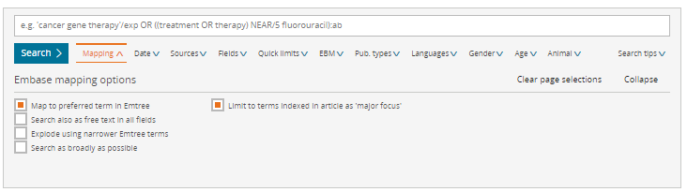
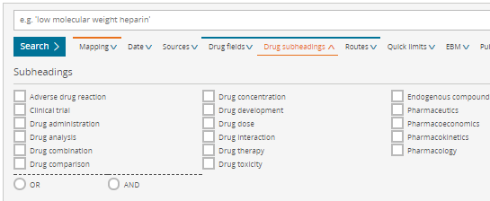
Balance comprehension and precision
To increase comprehension
  Include sub-terms/derivatives with an explosion search
  Include synonyms in a free text search => PICO form can help
To increase precision
  Incorporate limits
  Restrict to records where your search term are indexed as the key point or major focus of the articles found
  Use disease, drug and device subheadings
Notes:
using different mapping is to balance between precision and recall.
Increase precision
Apply limits
Restrict to records as indexed term or as a major focus
Use disease, drug and device subheadings
Use left column filters

Slide 45
Tips for searching – Boolean operators
The Boolean logical operators AND, OR, NOT, NEAR and NEXT can be used to combine search terms or query numbers in a variety of ways:
  Aged OR elderly OR geriatric – At least one word must be mentioned in each record
  Depression AND tricyclic – Both words must be present in each record
Boolean operators can be combined and nested with parentheses within a single search statement:
OR
AND
Notes:
Some more tips for searching:
The Boolean operators AND, OR, NOT, NEAR and NEXT can be used to combine search terms:
Using OR means At least one word must be mentioned in each record
Using AND gives the results that Both words are present in each record
Boolean operators can be combined and nested with parentheses within a single search statement:

Slide 46
Tips for searching
When conducting a search of Article title and Abstract for author free-text expressions consider using proximity operators (NEXT, NEAR) as appropriate
When performing free-text searches, remember to consider variant spellings including British and American spellings and terminology
–e.g., tumor vs tumour; diaper vs nappy; pediatric vs paediatric; otorhinolaryngology vs ear, nose and throat; overuse injury vs repetitive strain injury
cardiac NEAR/5 catheter retrieves:
"Despite complicated cardiac anatomy,
catheter ablation of AT..."
"... patients undergoing catheter ablation for
cardiac arrhythmias ..."
"...a continuous thermodilution cardiac
output pulmonary artery catheter."
Notes:
Using Proximity operators to search for words or phrases at any specified distance from each other
cardiac NEAR/5 catheter
Retrieves when two words are within 5 words, in either direction.
When performing free-text searches, remember to consider variant spellings including British and American spellings and terminology

Slide 47

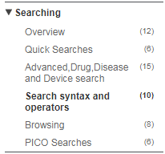
Where Can you Learn More?
New Embase Support Center
Notes:
On search page, looking for “search tips” drop down button
Embase help page: find the answers to Frequently Asked Questions, Guides, Instructional Videos and links to archived webinar recordings
Expect new support center will be launched soon, easy to navigate and more interactive help pages

Slide 48
Demo
Notes:
Quick search: search entire database via an explosion search
Results page query line, direct search or using Mapping filter
Mapping (/de, /exp): synonym is mapped to preferred term
Search ALSO as free text
Search as broadly as possible /br
“stem cell therapy”/de
“stem cell transplantation”/de
“stem cell transplantation”/exp
“stem cell therapy”/exp
“stem cell transplantation”/exp
“stem cell therapy”/br = “stem cell therapy”/exp OR “stem cell therapy”
“stem cell transplantation”/br = “stem cell transplantation”/exp OR “stem cell transplantation”

Slide 49
PICO
What are the best empirical antibiotic treatment options for bacterial meningitis?
('bacterial meningitis'/exp OR 'bacterial meningitis':ti,ab OR 'e. coli meningitis':ti,ab OR 'escherichia coli meningitis':ti,ab OR 'meningitis purulenta':ti,ab OR 'meningitis, bacterial':ti,ab OR 'meningitis, escherichia coli':ti,ab OR 'meningitis, pyogenic':ti,ab OR 'purulent meningitis':ti,ab OR 'pyogenic meningitis':ti,ab) AND ('antibiotic agent'/exp OR 'antibiotic':ti,ab OR 'antibiotic agent':ti,ab OR 'antibiotic combination':ti,ab OR 'antibiotic drug':ti,ab OR 'antibiotic ointment':ti,ab OR 'antibiotic residue':ti,ab OR 'antibiotic spectrum':ti,ab OR 'antibiotics':ti,ab OR 'antibiotics and their derivatives':ti,ab OR 'antibiotics, combined':ti,ab OR 'antibiotics, folate antagonists':ti,ab OR 'antibiotics, miscellaneous':ti,ab OR 'antibiotics, nitrofuran':ti,ab OR 'antibiotics, oxalodinones':ti,ab OR 'combined antibiotic':ti,ab)
Notes:
Population = patients with bacterial meningitis + synonyms (:ti,ab) or all fields
Intervention = antibiotic agent + synonyms (:ti,ab) or all fields
Comparison = no treatment
Outcome = (blank)

Slide 50
PV Wizard
Identify all the adverse events that mentioned paracetamol

Slide 51
PICO
Compare the everolimus eluting coronary stent with biolimus eluting coronary stent
('everolimus eluting coronary stent'/exp OR 'promus element' OR 'xience xpedition' OR 'xience-v' OR 'everolimus eluting coronary stent' OR 'xience' OR 'xience v') AND ('biolimus eluting coronary stent'/exp OR 'biolimus a9 (device)' OR 'biolimus eluting coronary stent' OR 'umirolimus eluting coronary stent')
Notes:
Intervention: everolimus eluting coronary stent + synonyms (all fields)
Comparison: biolimus eluting coronary stent + synonyms (all fields)

Slide 52
Drug and Disease search
Recent reports of cardiac adverse effects of beta agonists in the treatment of asthma patients
#1 'beta adrenergic receptor stimulating agent'/exp/dd_ae OR 'beta adrenergic receptor stimulating agent'
#2 'asthma'/exp/dm_dt
#3 'heart disease'/exp/dm_si
#1 AND #2 AND #3
Notes:
Drug search: beta agonist, subheading: adverse drug reaction
Disease: asthma subheading: therapy
Disease: heart disease subheading: side effect
Combine, and select records added date
Save the search query, set up email alert

Slide 53
Thank you!
Questions?
Contact: XXXXX@elsevier.com

Slide 54
Searching basics to master
Boolean operators
The Boolean logical operators AND, OR, NOT, NEAR and NEXT can be used to combine search terms or query numbers in a variety of ways:
  Depression AND tricyclic – Both words must be present in each record
  Aged OR elderly OR geriatric – At least one word must be mentioned in each record
Boolean operators can be combined and nested with parentheses within a single search statement:
  (aged OR elderly OR geriatric) AND (depression OR insomnia)
Notes:
If no other operator is specified, AND is the default operator; heart failure is searched as heart AND failure if not enclosed in quotation marks
Boolean operators can be used in any search form, including Quick Search
Phrases: searched in quotation marks; ‘heart failure’

Slide 55
Searching basics to master
Proximity operators
Proximity operators let you search for words or phrases at any specified distance from each other
Notes:
The proximity operators NEAR and NEXT can be used with parentheses, truncation and field limits, for example: (symptom* NEAR/5 (headache* OR ‘head ache’)):TI,AB
NEAR/n:
This requests terms which are within ‘n’ words of each other, in either direction.
cardiac NEAR/5 catheter retrieves:
"Despite complicated cardiac anatomy,
catheter ablation of AT..."
"... patients undergoing catheter ablation for
cardiac arrhythmias ..."
"...a continuous thermodilution cardiac
output pulmonary artery catheter."
NEXT/n:
This requests terms which are within ‘n’ words of each other, in the order specified.
hip NEXT/3 prosthesis retrieves:
"... rheumatoid arthritis, joint surgery, hip or knee prosthesis ..."
"metal on metal hip resurfacing, prosthesis failure (complication, diagnosis)..."

Slide 56
Searching basics to master
Wildcard operators
Wildcards (truncation characters) let you search for word roots, variations in spelling, many plural forms, etc.
  Variable truncation: Use an asterisk (*)
    sul*ur retrieves sulfur, sulphur
    cat* retrieves cat, cats, catalyst, catastrophe
  A question mark (?) indicates exactly one variable character
    sulf?nyl retrieves records that contain words like 'sulfonyl' and 'sulfinyl'
    catheter? retrieves records that contain words like 'catheters', but not 'catheter' or 'catheterization‘
Notes:
Wildcards (*, ?) are now searchable in phrases e.g. ‘heart infarct*’ or "metabol* disorder*’
The wildcard * cannot be used with fewer than two characters e.g. ‘m* disorder’ will not return results

